Slide 1
Modern Atomic Theory and the Periodic Table
Chapter 10
Outline
Electromagnetic Radiation
Atomic Spectra
Energy Levels
Sublevels and Orbitals
Orbital Diagrams
Electron Configurations

Slide 2
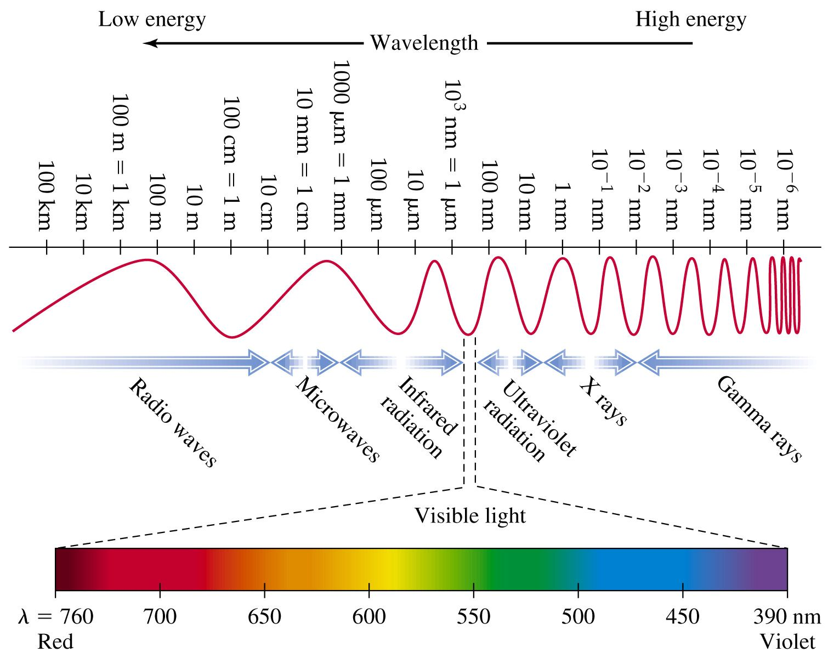
What is the electromagnetic spectrum?

Slide 3
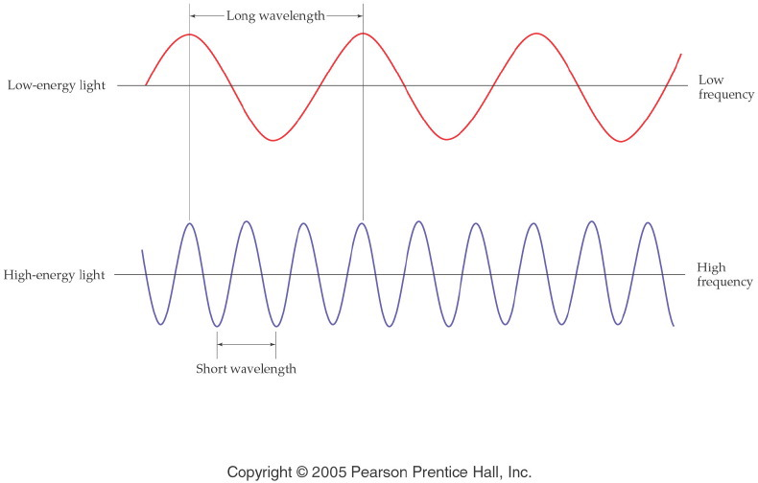
How do waves travel? How are energy, frequency and wavelength related?
Notes:
Figure: 05-07
Title:
Wavelength and Frequency
Caption:
Notice that the wavelength is longer for low-energy light than for high-energy light. Frequency is opposite.
Notes:
Wavelength and frequency are inversely related to each other through the speed of light. A small wavelength means that more waves (i.e., more energy) pass through a point per second.

Slide 4
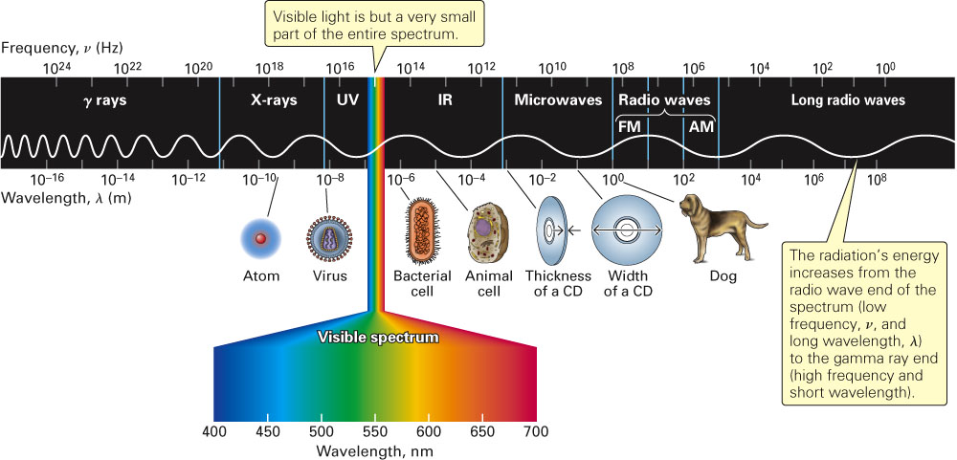
What are the relative sizes of the waves in the electromagnetic spectrum?
Fig. 11-1, p. 310

Slide 5
Example – Electromagnetic Spectrum
Using violet, green, and orange, which one is the most energetic?
Violet
Green
Orange
All of the above
None of the above

Slide 6
Example – Electromagnetic Spectrum
Order the following in increasing wavelength: x-rays, ultraviolet light, FM radiowaves, and microwaves
X-rays < UV light < FM radiowaves < microwaves
X-rays < UV light < microwaves < FM radiowaves
FM radiowaves < microwaves < X-rays < UV light
FM radiowaves < microwaves < UV light < X-rays
None of the above

Slide 7
Experiment 1
What happens when an elemental gas in a cathode ray tube is exposed to electricity?
  Hydrogen (H₂) purple-blue
  Neon (Ne) red-orange
  Helium (He) yellow-pink
  Argon (Ar) lavender
  Xenon (Xe) blue

Slide 8
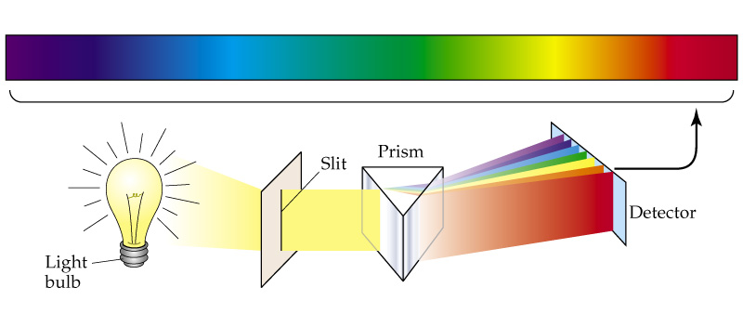
Experiment 2
What happens when a white light is shown through a prism? -- rainbow
A prism separates light of different wavelength, each color represents a different wavelength.

Slide 9
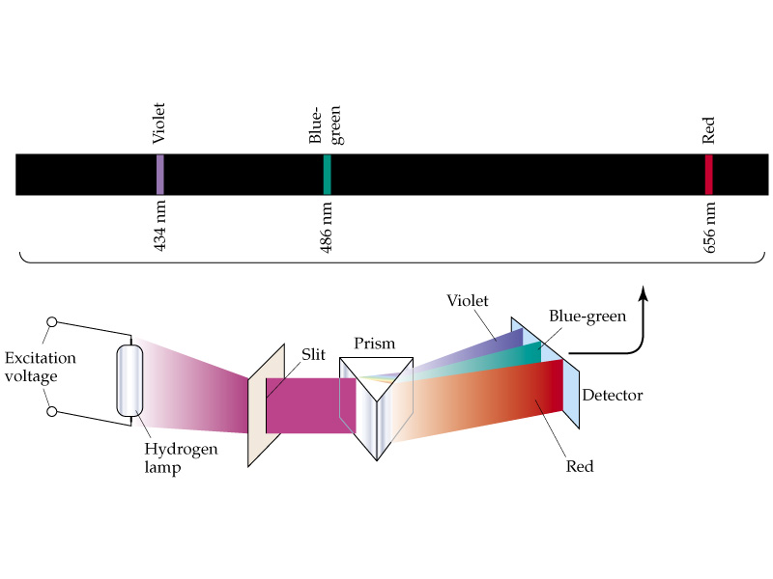
Experiment 3
What happens when colored light from a gas discharge tube is shown through a prism? -----distinct bands of color (light).
http://jersey.uoregon.edu/vlab/elements/Elements.html

Slide 10
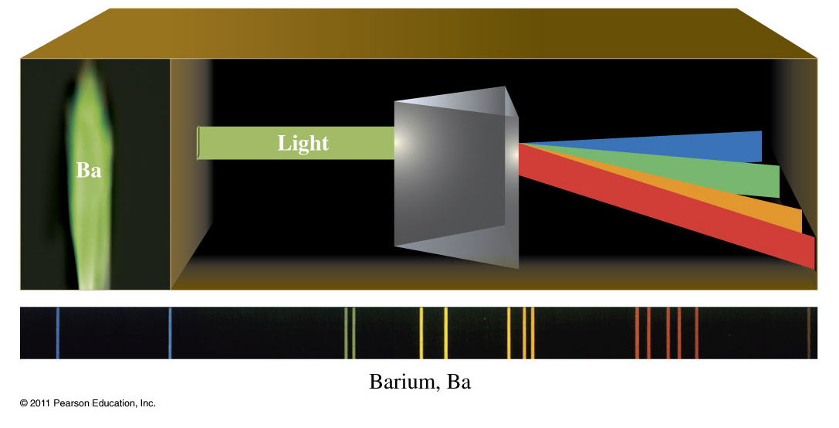
What is the atomic spectrum of Barium?

Slide 11
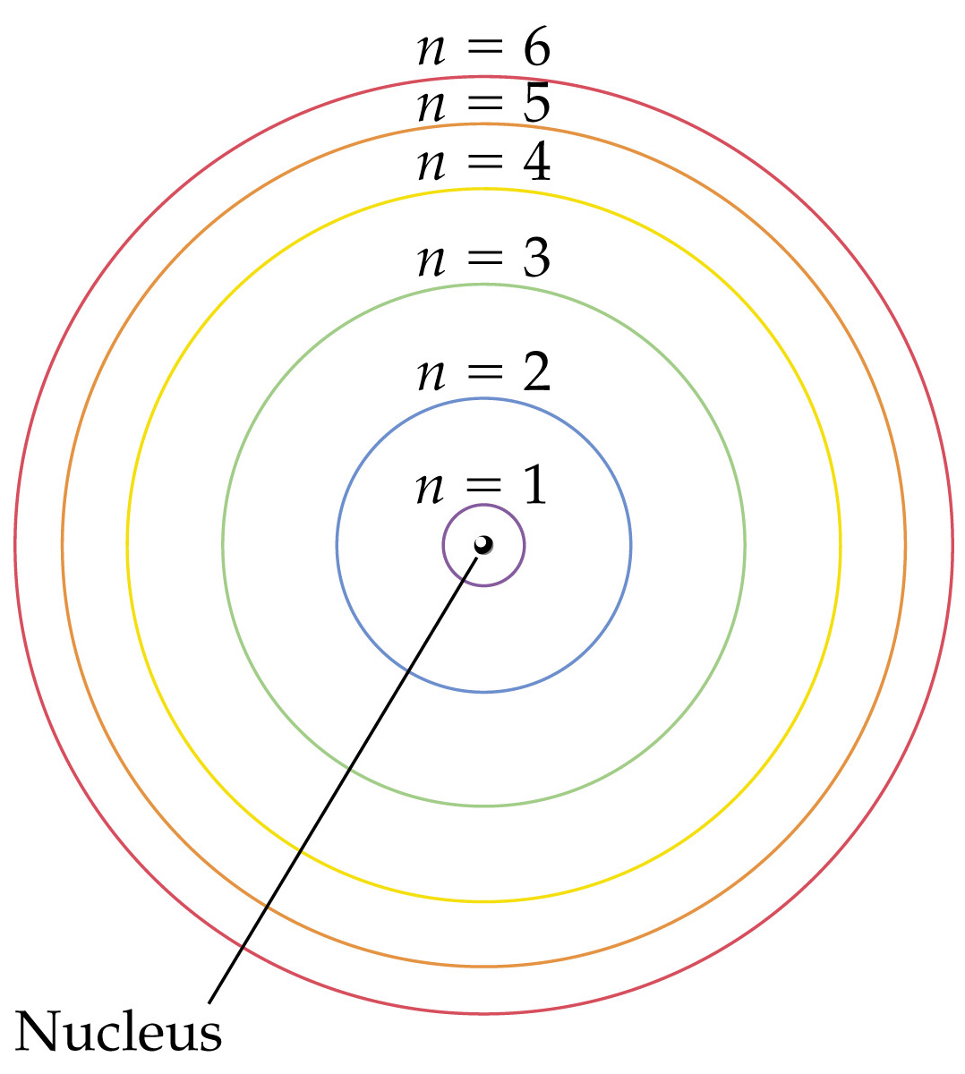
How are the electrons distributed in the Bohr model of the atom?
Notes:
Figure: 09-09
Title:
The Bohr model of the atom, showing electron orbits

Slide 12
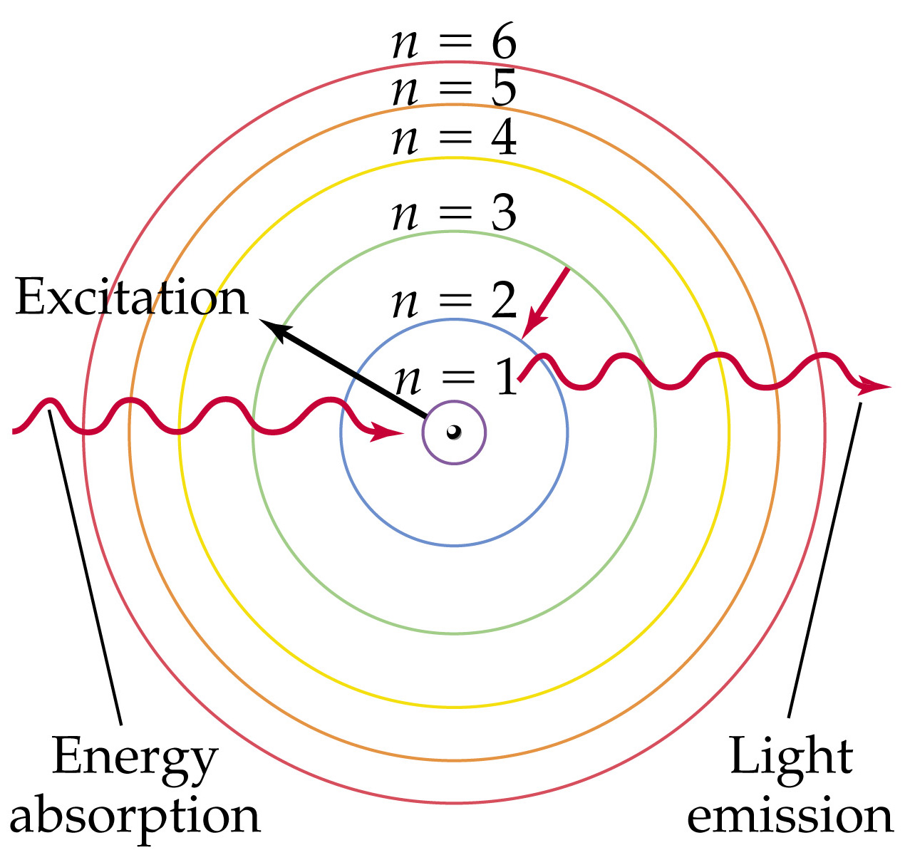
How are the spectra produced?
Notes:
Figure: 09-11
Title:
Energy absorption and light emission in a Bohr hydrogen atom

Slide 13
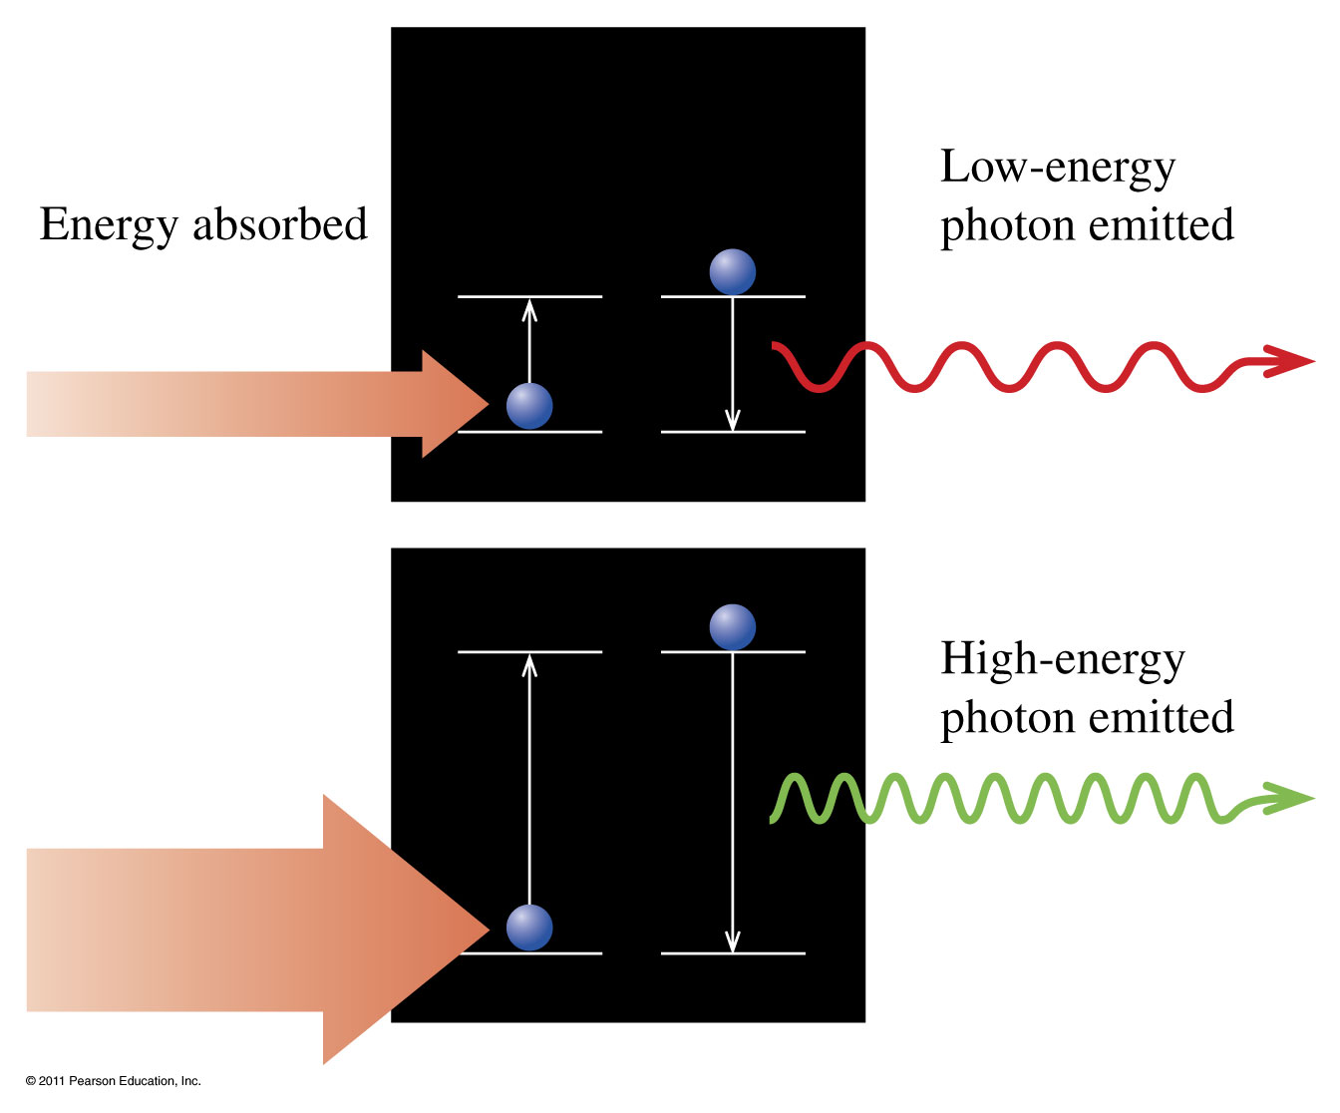
Does the amount of energy absorbed matter?

Slide 14
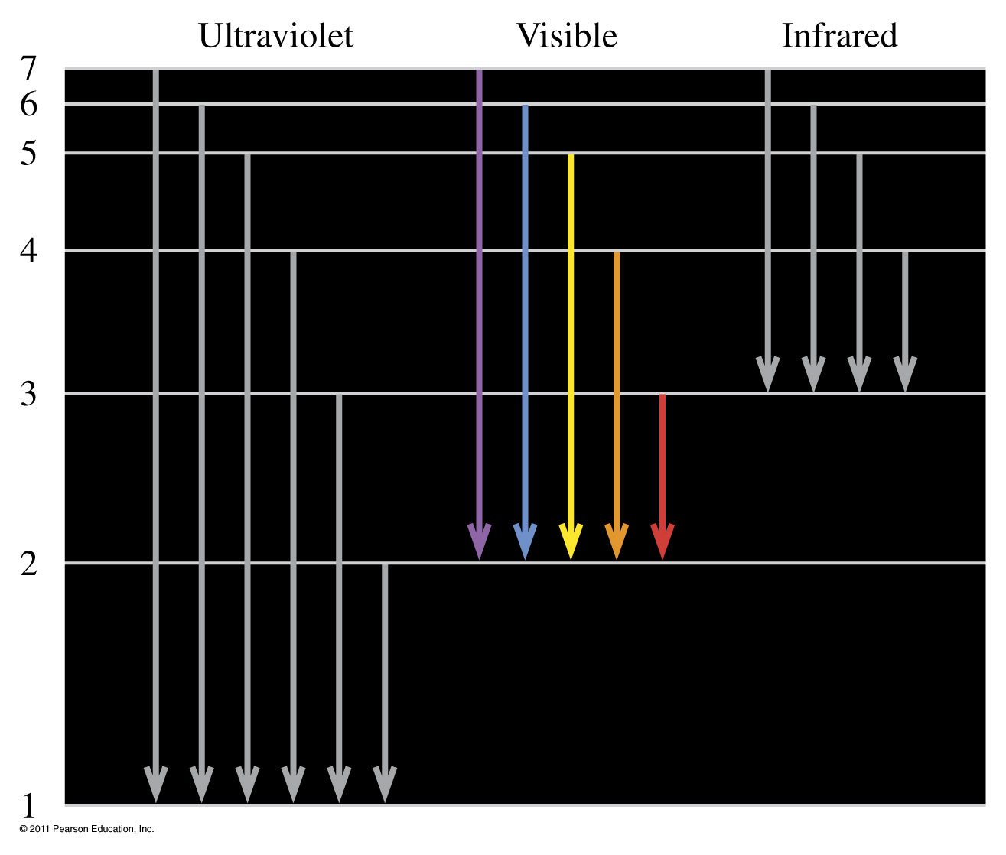
When electrons drop from a higher level to the first level, second level, and third level, photons of ultraviolet light, visible light, and infrared are emitted (not to scale).

Slide 15
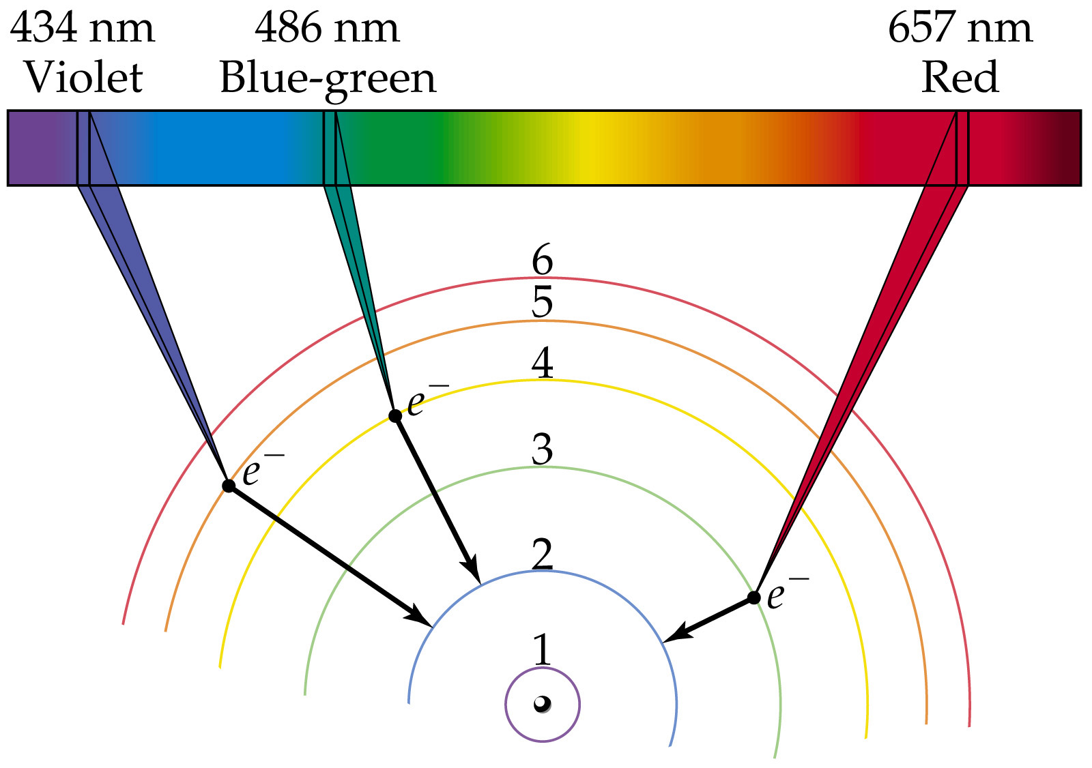
What happens in the hydrogen spectrum?
Notes:
Figure: 09-12
Title:
Visible lines in emission spectrum of a Bohr hydrogen atom

Slide 16
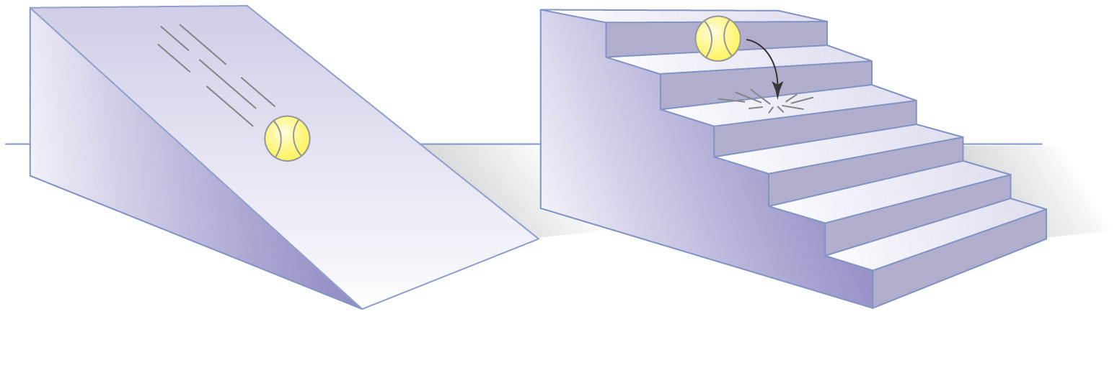
What is does it mean to be quantized?

Slide 17
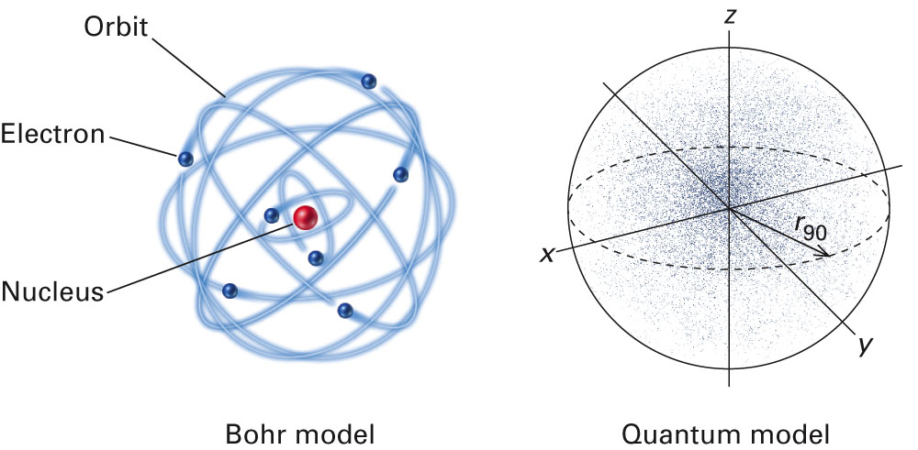
How are the Bohr model and the Quantum model different?
Fig. 11-10, p. 316

Slide 18
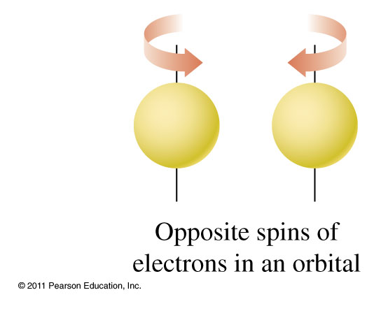

How do electrons go into orbitals?

Slide 19
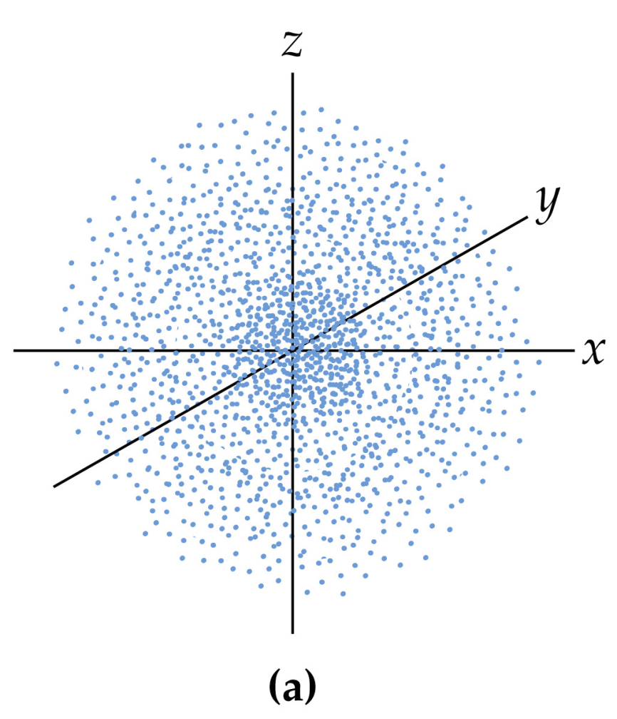
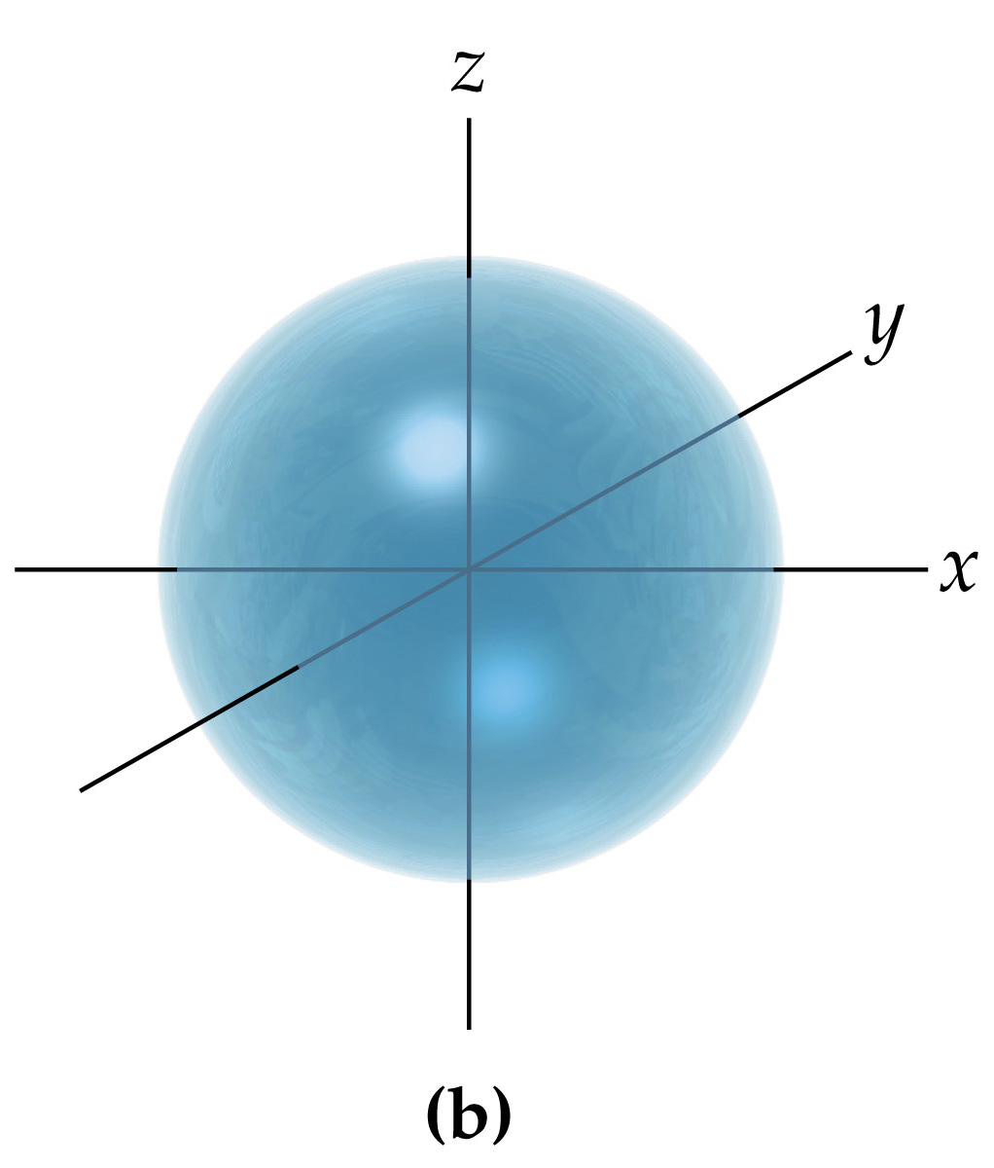
What is an s orbitals?
• spherical in shape
Electron density map
Representation of volume of orbital

Slide 20
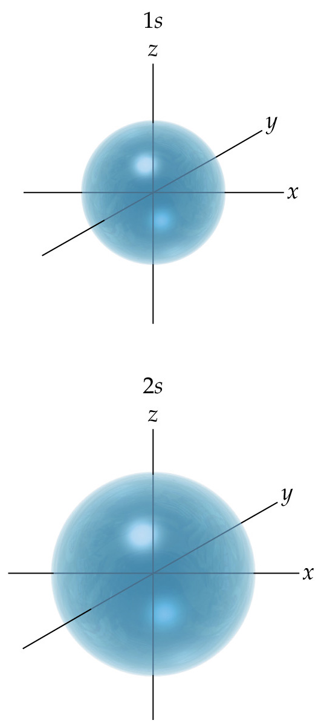
How does the size of an s orbital change as the energy level increases?
Notes:
Figure: 09-20
Title:
Comparison of 1s and 2s orbitals

Slide 21
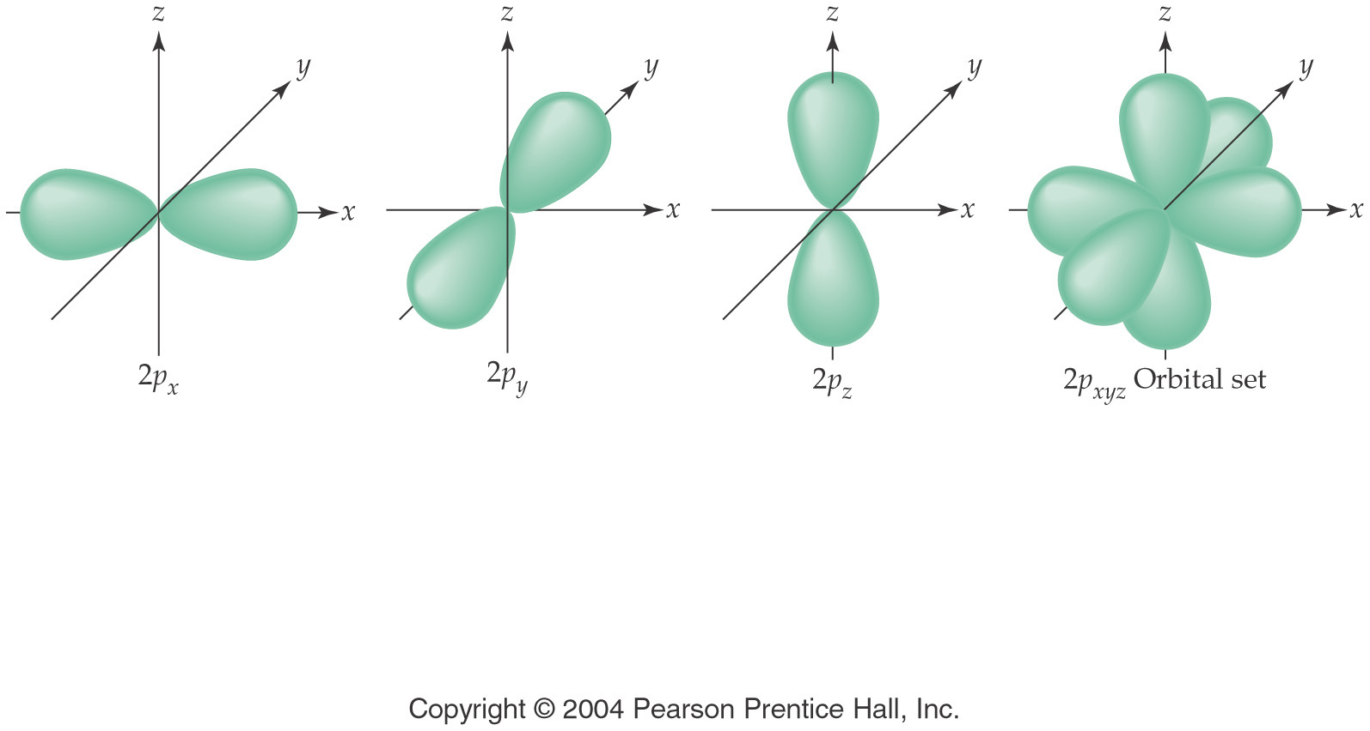
What is a p orbital?
• dumbbell shaped
• three different spatial orientations

Slide 22
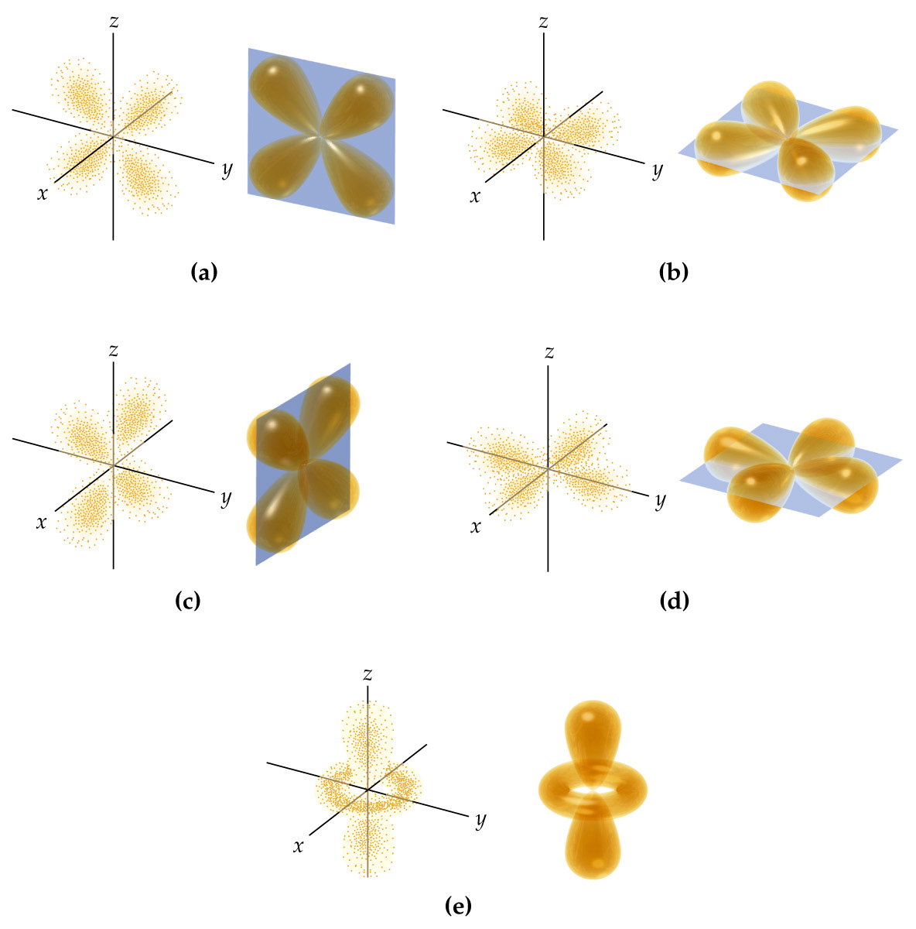
What is a d orbital?
4 leaf clover shape and a dumbbell with a doughnut
5 different orientations

Slide 23
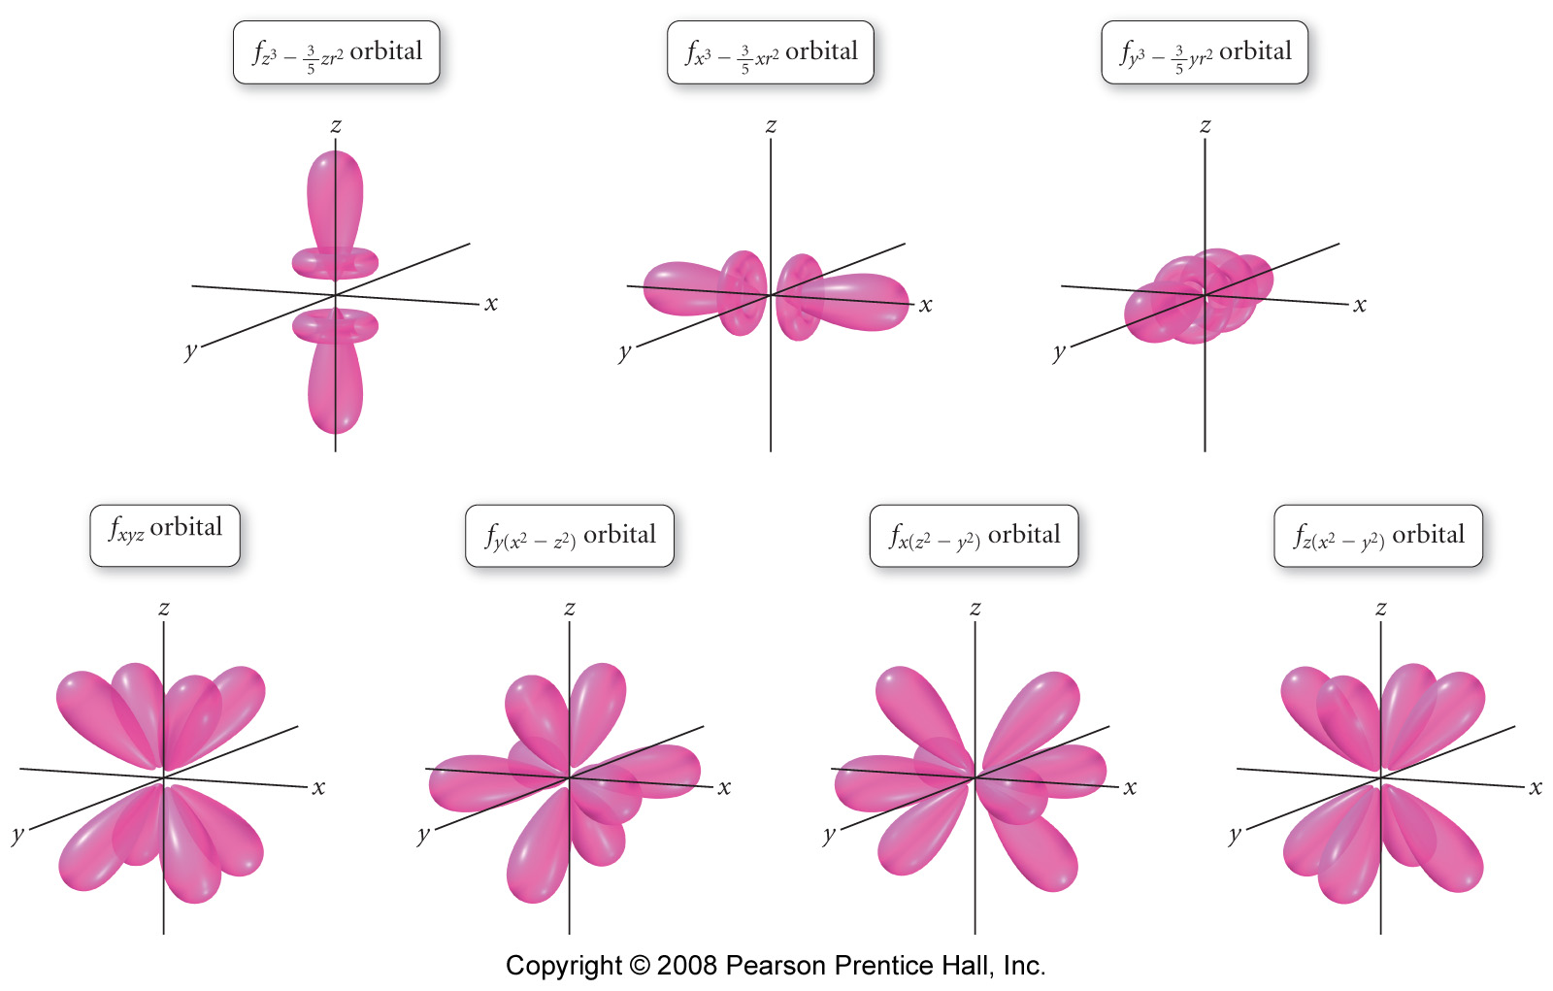
What is an f orbital?
Complex shapes
7 different orientations

Slide 24
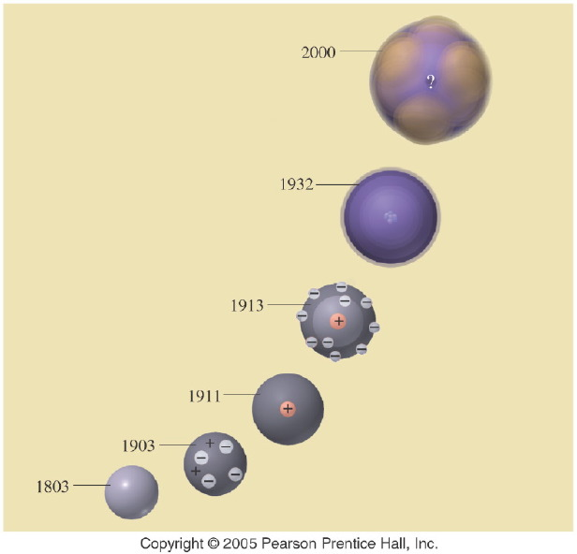
How has the model of the atom changed over time?
Notes:
Figure: 05-20-02UN
Title:
Atomic Models
Caption:
In the evolving model of the atom, what does the question mark (?) represent in the 2000 model?
Notes:
Atomic theory is one scientific theory that has been adjusted over the years as new evidence has come to light. It is still changing today.

Slide 25
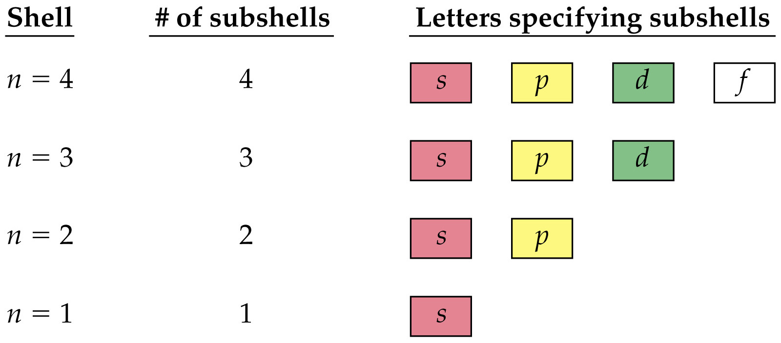
Notes:
Figure: 09-19
Title:
Shells are organized into subshells

Slide 26
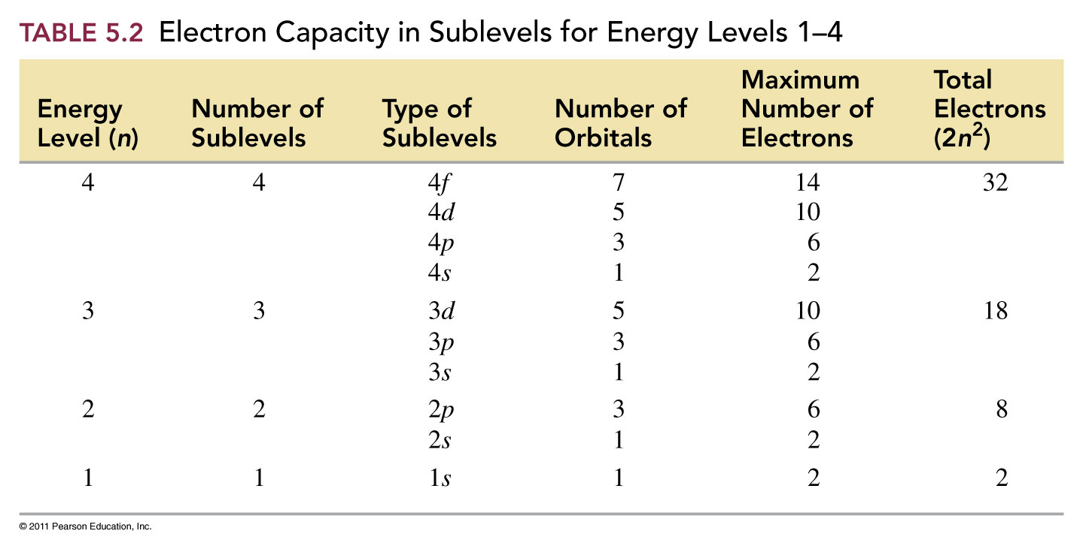

Slide 27
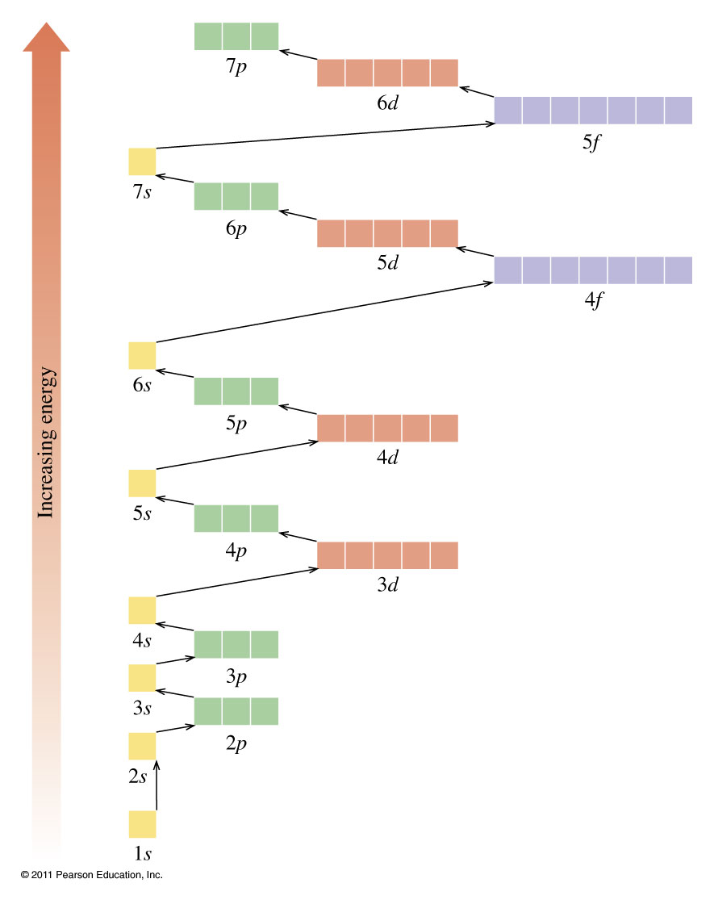

Slide 28
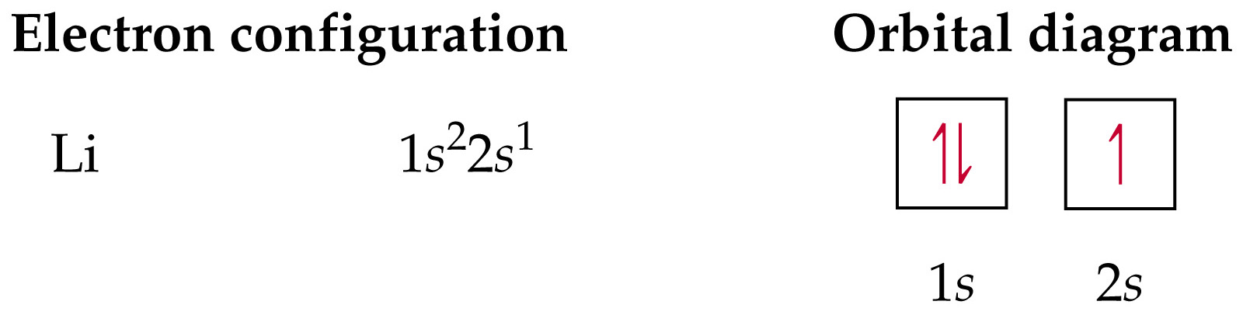
Notes:
Figure: 09-26-01un
Title:
Orbital diagram and electron configuration for a ground state lithium atom

Slide 29
Example – Electron Configuration
What is the electron configuration of C?
1s² 2s² 2p²
1s² 1p⁴
2s² 2p²
1s⁶
None of the above

Slide 30
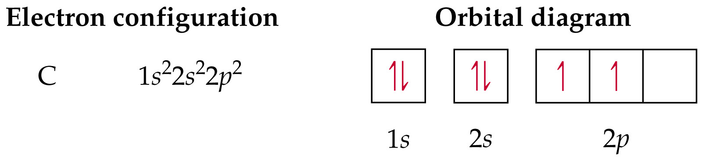
Notes:
Figure: 09-26-02un
Title:
Orbital diagram and electron configuration for a ground state carbon atom

Slide 31
Example – Electron Configuration
What element has an electron configuration of 1s² 2s² 2p⁶ 3s¹?

Slide 32
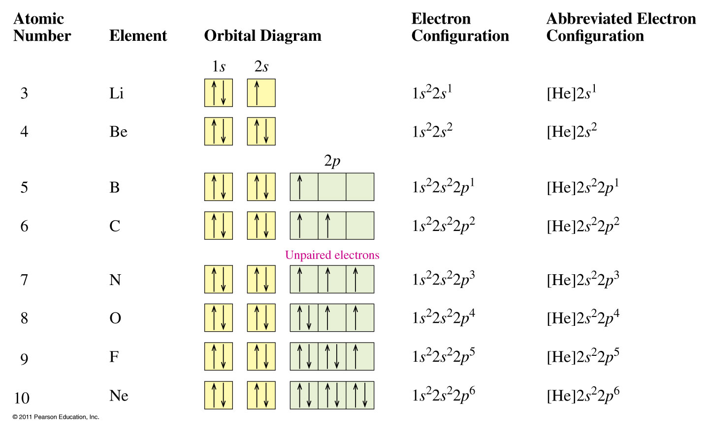

Slide 33
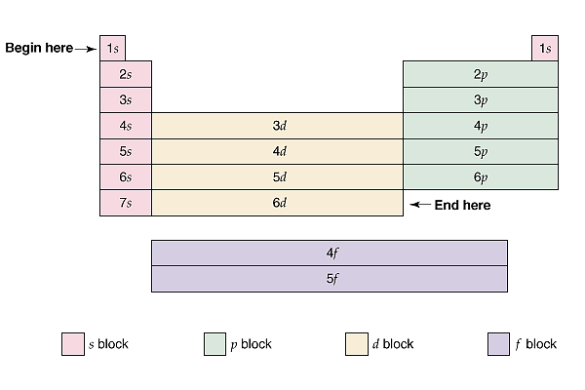

Slide 34
Expanded Periodic Table

Slide 35
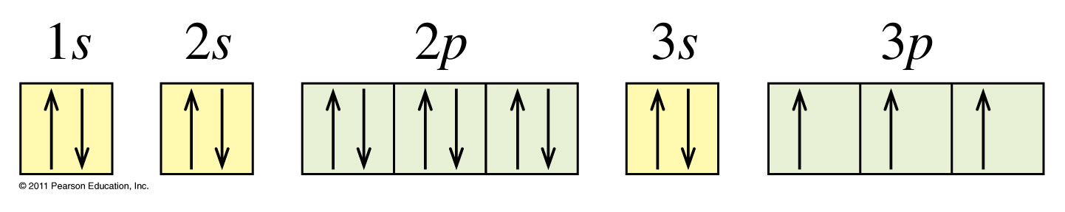
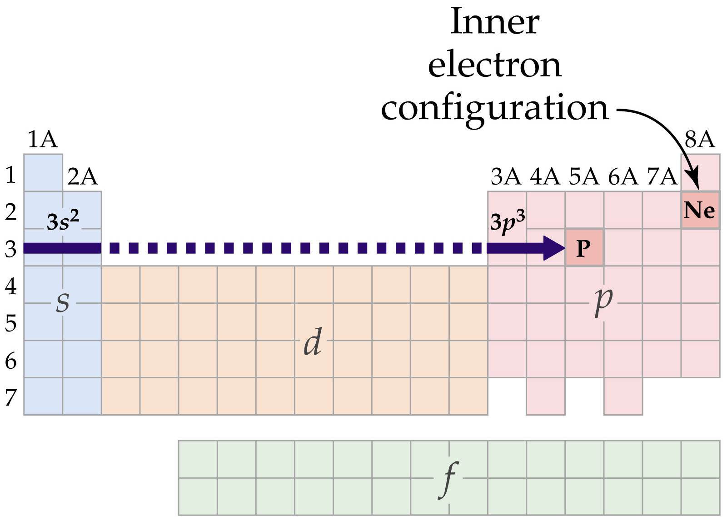
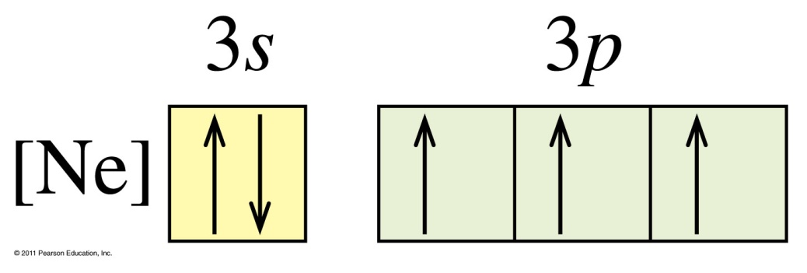
Phosphorous

Slide 36
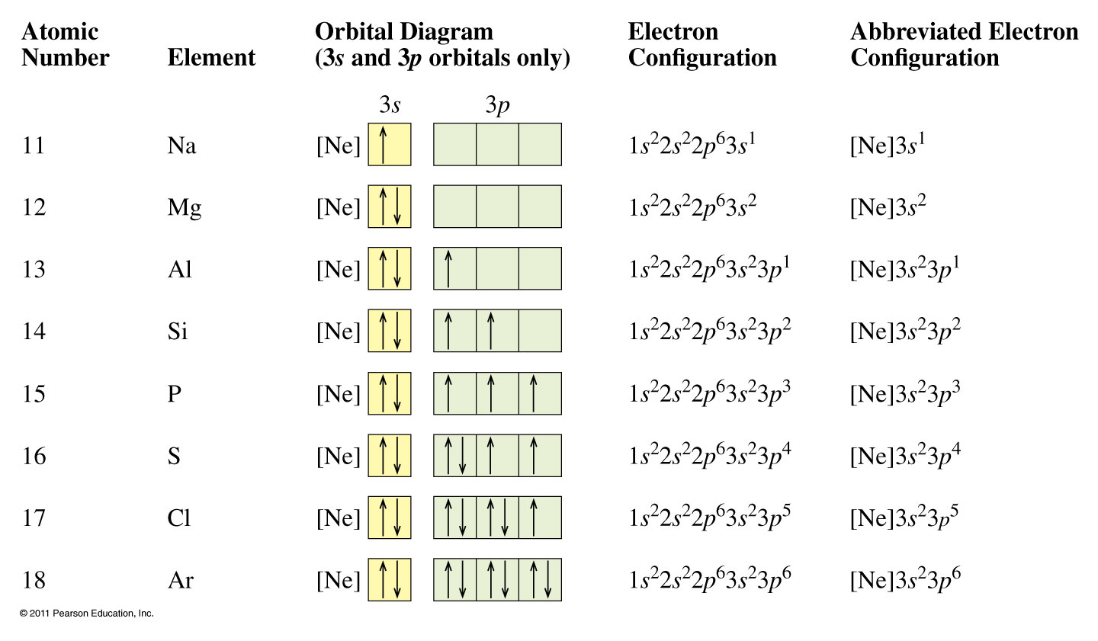

Slide 37
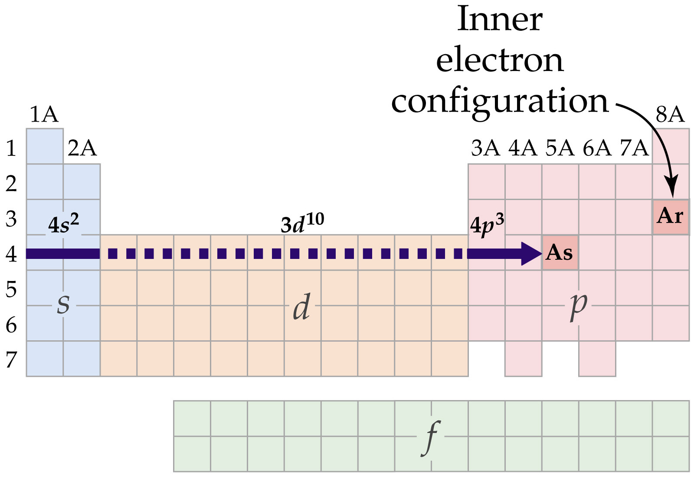
Notes:
Figure: 09-31
Title:
The periodic table gives the electron configuration for As

Slide 38
Example – Electron Configuration
What is the electron configuration of vanadium, V?
1s² 2s² 2p⁶ 3s² 3p⁶ 4s² 4d³
1s² 2s² 2p⁶ 3s2 3p⁶ 4s⁵
1s² 2s² 2p⁶ 3s³ 3p⁶ 4s² 3d²
1s² 2s² 2p⁶ 3s² 3p⁶ 4s² 3d³
None of the above

Slide 39
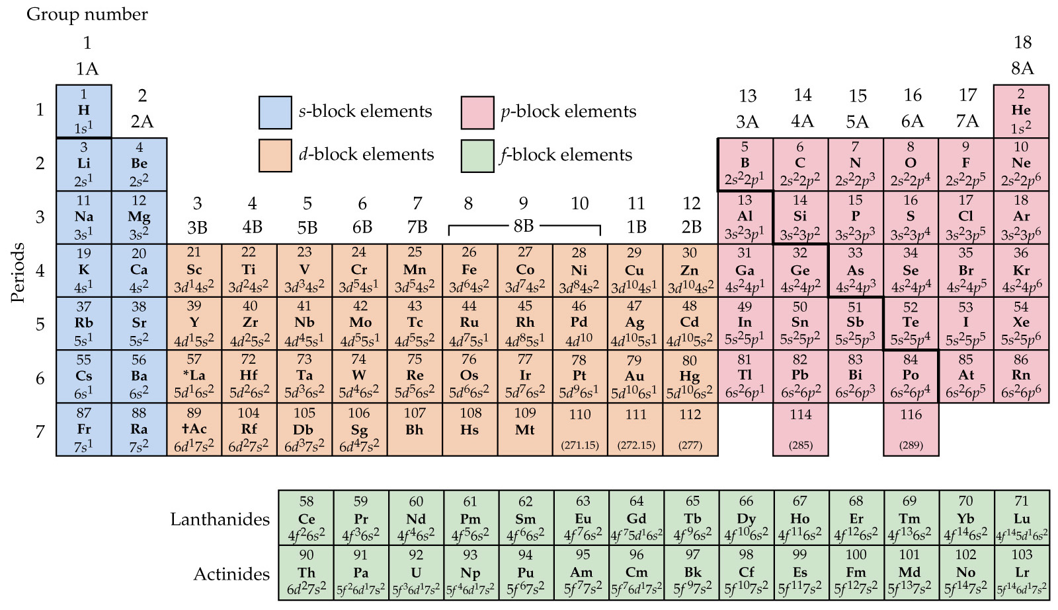
Notes:
Figure: 09-29
Title:
Outer electron configuration for the elements

Slide 40
Example – Electron Configuration
How many core electrons does aluminum have?
2
3
4
6
10

Slide 41
Example – Electron Configuration
How many valence electrons does aluminum have?
2
3
4
6
10

Slide 42
Example – Electron Configuration
Write the core notation for Pb.
[Xe] 6s² 6p²
6s² 5d¹⁰ 4f¹⁴ 6p²
1s² 2s² 2p⁶ 3s² 3p⁶ 4s² 3d¹⁰ 4p⁶ 5s2 4d¹⁰ 5p⁶ 6s² 5d¹⁰ 4f¹⁴ 6p²
[Xe] 6s² 5d¹⁰ 4f¹⁴ 6p²
[Hg] 6p²

Slide 43
Example – Electron Configuration
Write the core notation for Pb²⁺.
[Xe] 5d¹⁰ 4f¹⁴ 6p²
[Xe] 6s²
6s² 5d¹⁰ 4f¹⁴
1s² 2s² 2p⁶ 3s² 3p⁶ 4s² 3d¹⁰ 4p⁶ 5s2 4d¹⁰ 5p⁶ 6s² 5d¹⁰ 4f¹⁴ 6p²
[Xe] 6s² 5d¹⁰ 4f¹⁴ 6p²

Slide 44
Example – Electron Configuration
Write the core notation for the oxide ion.
[Ne]
1s² 2s² 2p⁶ 3s² 3p⁶
[He] 3s² 3p⁶
[He] 3s² 3p⁴
A and C

Slide 45
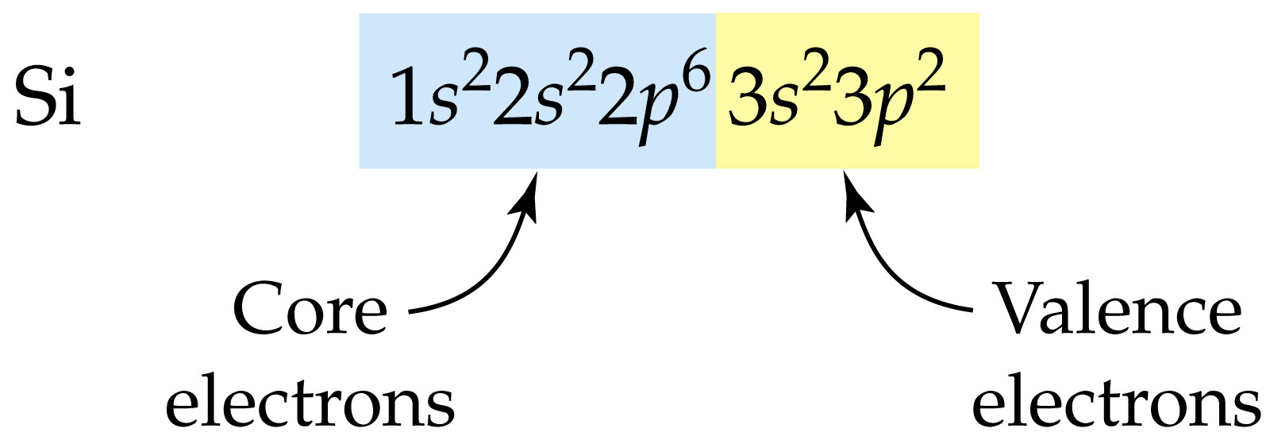
Notes:
Figure: 09-27-05un
Title:
Silicon's valence electrons

Slide 46
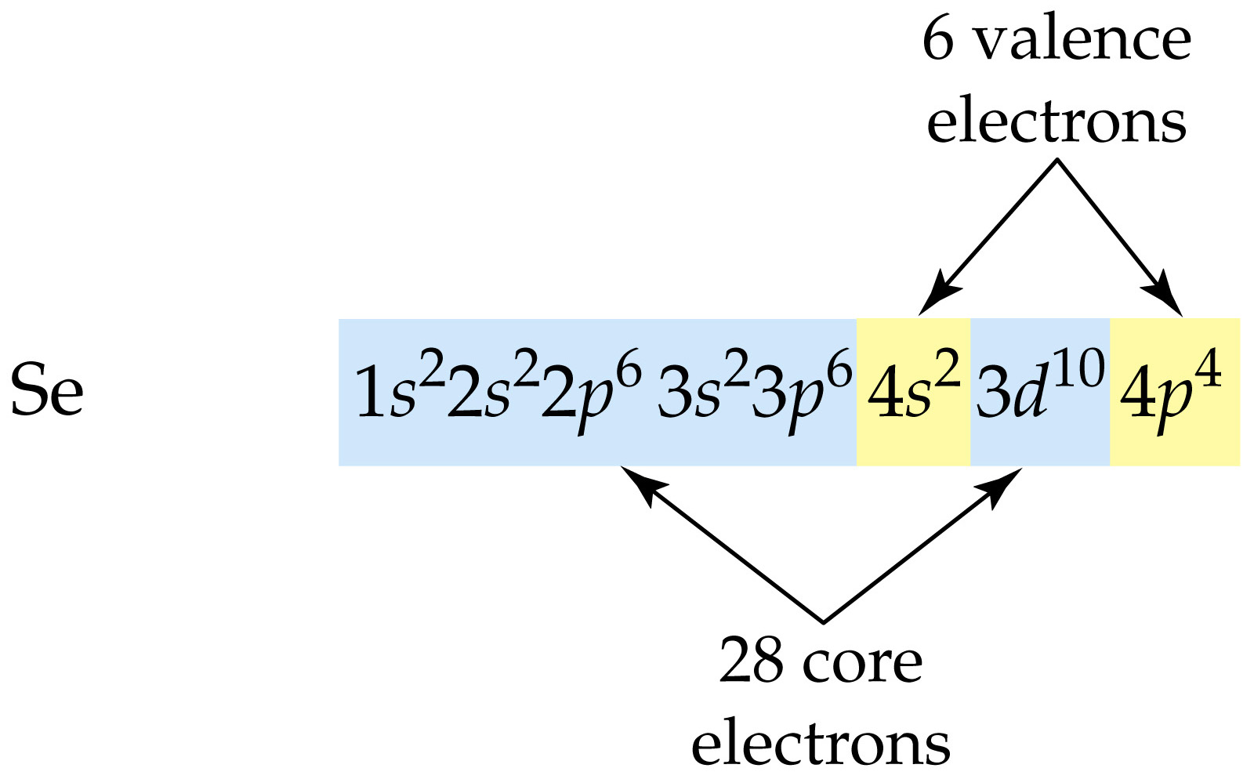
Notes:
Figure: 09-27-06un
Title:
Selenium's valence electrons

